Slide 1
Efficient Implementation of Lightweight Hash Functions on GPU and Quantum Computers for IoT Applications
Notes:
네 안녕하세요
논문 제목 Efficient implementation of Lightweight hash functions on GPU and Quantum computers for IoT Applications
에 대해서 발표하도록 하겠습니다.

Slide 2
01
Overview of IoT
02
Implementation (GPU)
Brief introduction to IoT applications and how hash functions are used to protect the security of IoT communication.
Detail description of the proposed efficient implementation techniques on GPU.
03
Implementation (QC)
04
Conclusions
Explanation on how to implement hash functions on quantum computer efficiently
How to capitalize the research output.
Notes:
발표 목차는 다음과 같습니다.

Slide 3
Overview of IoT Applications
Notes:
저희가 타겟으로 하는 IOT 통신 환경에 대해 간단히 살펴보면

Slide 4
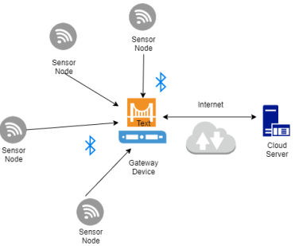
IoT Communication Architecture
During communication, sensor data may be tampered by attackers.
We need to use hash functions to protect the integrity of sensor data.
However, under IoT communication architecture, gateway device and cloud server need to handle massive connections from sensor nodes.
This creates a lot of work to verify the integrity of sensor data: many hashing operations are required!!
Notes:
IoT 통신과정에서 생성되는 센서 데이터는 공격자에의해 변조될 가능성이 있습니다.
따라서 저희는 데이터의 무결성을 보호하기위해 해시함수를 사용해야 합니다.
그런데 IoT 환경에서 생성되는 방대한 양의 데이터를 모두 검증하기 위해서는 많은 해싱 작업들이 필요합니다.

Slide 5
Contributions of this Project
The first efficient implementations of NIST LWC hash functions(final list) (PHOTON-Beetle, ASCON, Xoodyak, and SPARKLE) on GPU platforms. This can be used for securing IoT communication or brute-force attack.
The first implementation of LWC hash functions on quantum computers. This can be used for brute-force attack to evaluate the post-quantum strength of these hash functions.
We share the GPU implementation codes in the public domain at: https://github.com/benlwk/lwcnist-finalists
Notes:
저희의 컨트리뷰션은 다음과 같습니다.
최초로 NIST LWC 공모전 파이널리스트의 모든 해시함수들을 GPU 상에서 효율적으로 구현합니다.
이는 안전한 IoT 통신 또는 brute-force 공격에 사용될 수 있습니다.
다음으로, 양자 컴퓨터상에서 최초로 구현합니다. 이는 양자 컴퓨터의 brute-force 공격에 사용될 있으며 저희는 공격 비용을 추정하여 해시함수의 양자 후 보안 강도를 평가합니다.
마지막으로 저희의 구현 코드는 온라인으로 공개되어 있습니다.

Slide 6
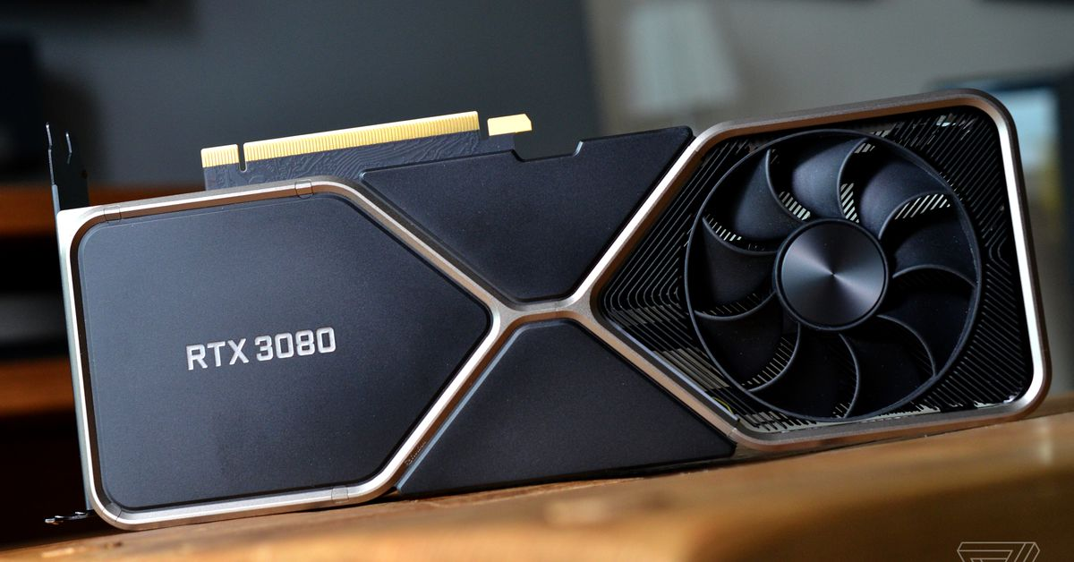
Implementation (GPU)
Description of the proposed efficient implementation techniques on GPU to accelerate PHOTON-Beetle, ASCON, Xoodyak, and SPARKLE hash functions .
Notes:
각 해시함수들의 GPU 구현에 대해서 간단히 발표하도록 하겠습니다.

Slide 7
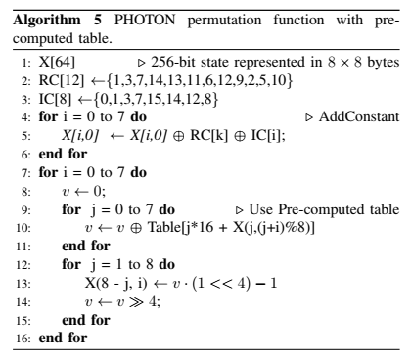
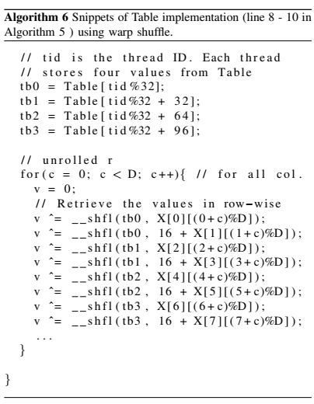
PHOTON-Beetle
Look-up table can be stored in shared memory (conventional way).
We proposed to store the table in registers, then access it through warp shuffle instructions.
Remove the potential bank conflicts in shared memory: faster performance.

Slide 8
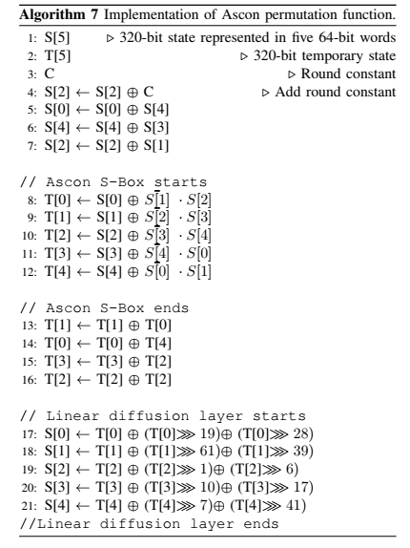
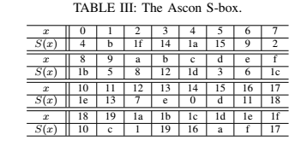
Ascon
Ascon is using a 5-bit S-box, can be implemented in a bit-slice manner.
Linear diffusion layer is also designed to be in a bit-slice manner.
Our implementation follow closely along this and proposed a bit-slice implementation on GPU (Algorithm 7).
All computations only involves logical operations, no table look-up. This is a more efficient than PHOTON-Beetle.

Slide 9
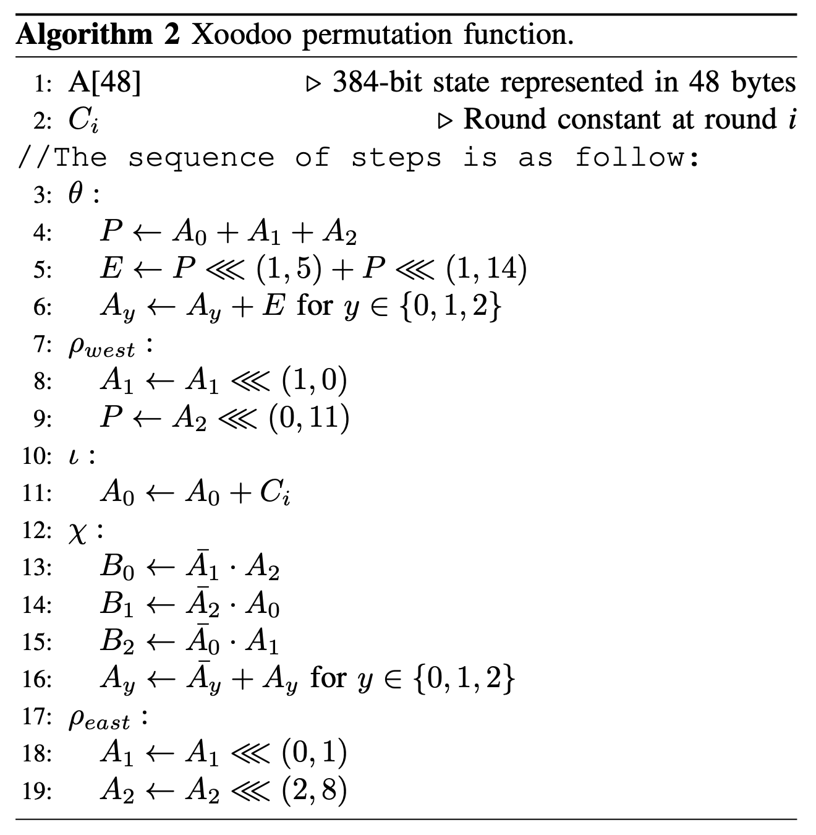
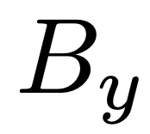
Xoodyak
Very similar to SHA-3 (Keccak) hash function.
Xoodoo does not have any S-box or ARX-box layer. Only simple logical operations are involved.
The round constants C_{i} are stored in constant memory. It is only read once and consumed by every thread, highly lightly to be cached in L1.
Storing C_{i} in shared memory does not show much benefit.

Slide 10
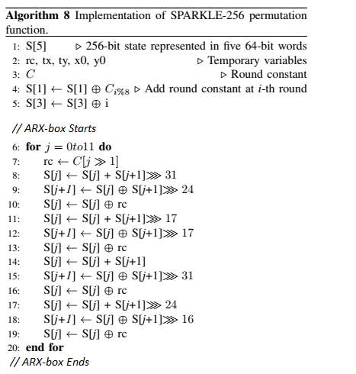
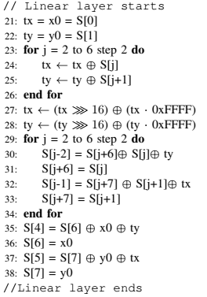
SPARKLE
The Alzette ARX-box in SPARKLE can be executed efficiently using only logical operations.
Similar to Xoodoo, round constants are stored in constant memory instead of shared memory.

Slide 11
Parallel Implementation on GPU
Adopt coarse grain parallelism
Each thread computes one hashing operation.
Many threads are hashing in parallel.
Many blocks are launched in parallel
This achieves massively parallel hashing to improve the throughput.
Maximize the performance of GPU (many active threads) and no synchronization between threads.
Thread 0
Thread 1
Block 0
Block N-1
Block N
Block (N-1)×(N-1)

Slide 12
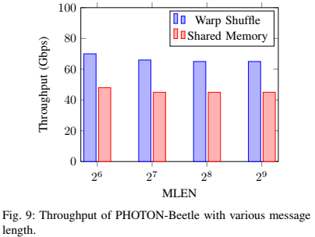
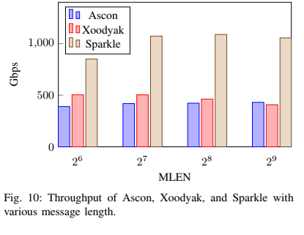
Results
PHOTON-Beetle is the slowest among all. The proposed technique (warp shuffle) is ~40% better than conventional implementation (shared memory).
PHOTON-Beetle uses byte-wise operations, which is efficient in constrained devices (e.g., an 8-bit microcontroller), but is not efficient in a GPU with a 32-bit architecture.
Sparkle is the fastest among all four finalist in NIST standardization of LWC.
Xoodyak and Ascon are having similar performance.
*
Experiments are carried out on an RTX 3080 GPU
(latest Ampere architecture).

Slide 13
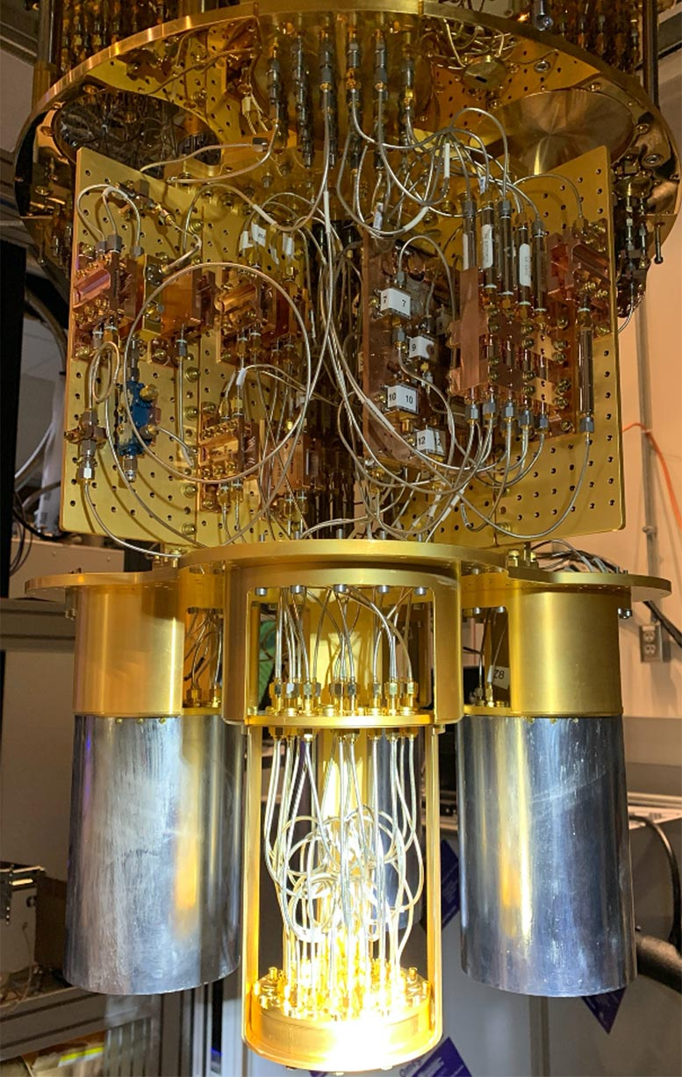
Implementation (QC)
Detail description of the proposed efficient implementation techniques on Quantum circuit to accelerate PHOTON-Beetle, ASCON, Xoodyak, and SPARKLE hash functions .
Notes:
각 해시함수들의 양자회로 구현에 대해서 간단히 발표하도록 하겠습니다.

Slide 14
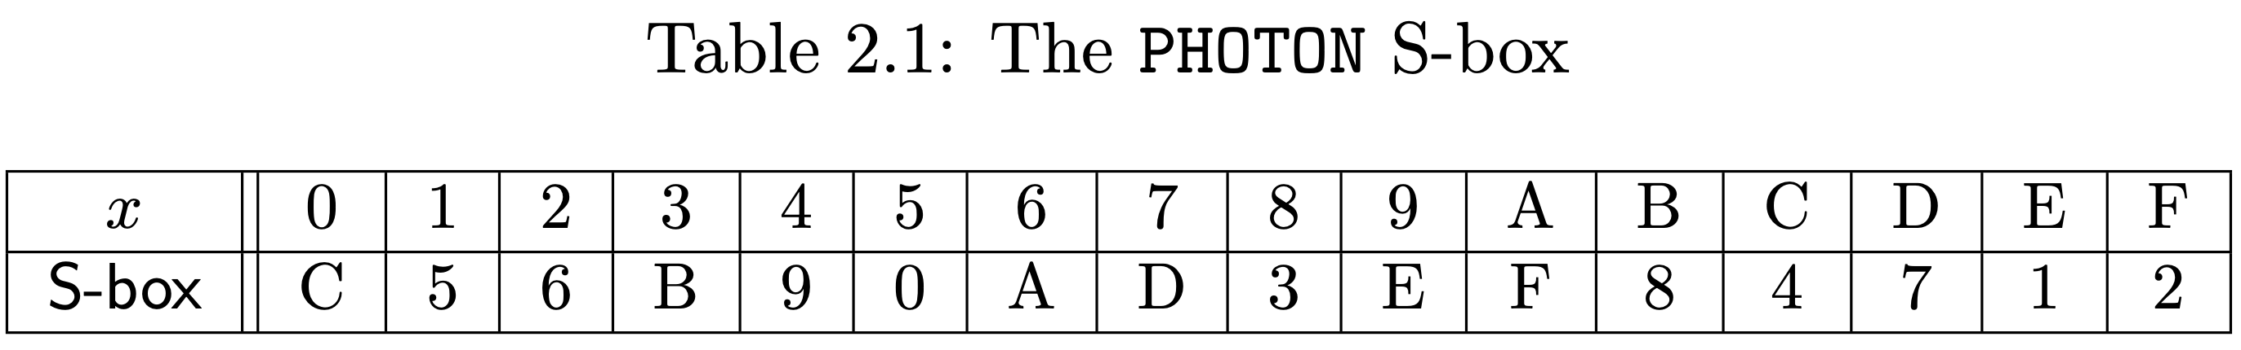
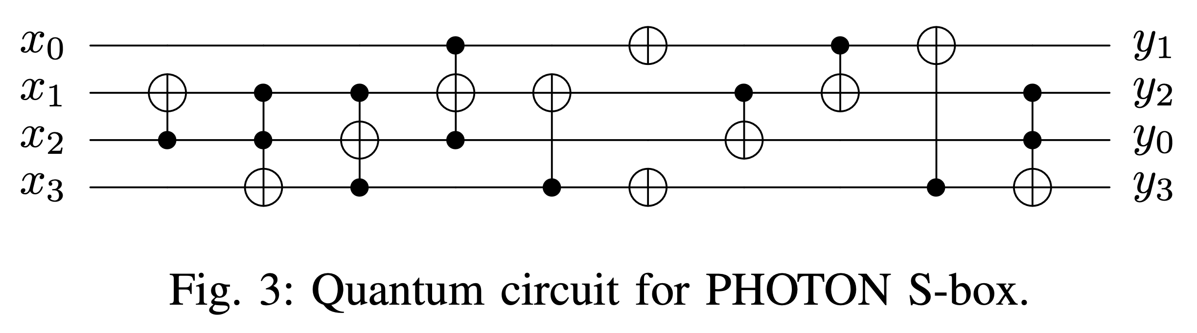
PHOTON-Beetle
When implementing an S-box in classical computing, a lookup table is a common choice.
However, in quantum computing(superposition), this approach is quite inefficient.
The LIGHTER-R* can find reversible implementations of the 4-bit S-box.
We use the LIGHTER-R to convert the look-up table into logical operations.
Through this, we can efficiently implement the look-up table as a quantum circuit.
*
V. A. Dasu, A. Baksi, S. Sarkar, and A. Chattopadhyay, “Lighter-r: Optimized reversible circuit implementation for sboxes,”
in 2019 32nd IEEE International System-on-Chip Conference (SOCC), 2019, pp. 260– 265.

Slide 15
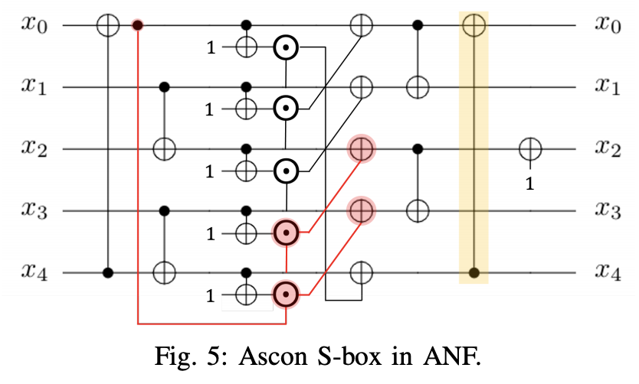
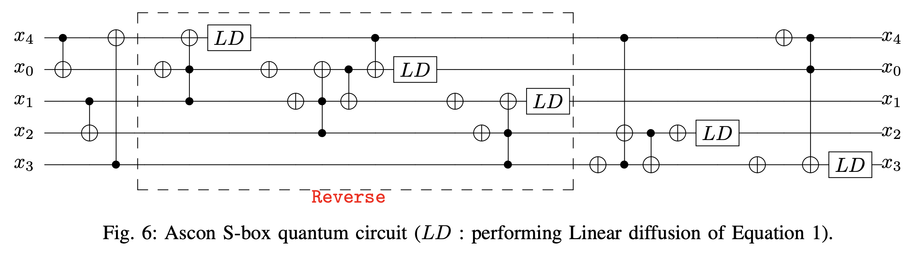
Ascon
Figure 5 is the logical operations of ASCON S-box, and the highlights indicate inefficient parts when implemented as a quantum circuit.
We implement the S-box efficiently by considering the S-box and the Linear Diffusion layer together
(not sequentially, Fig 6).

Slide 16
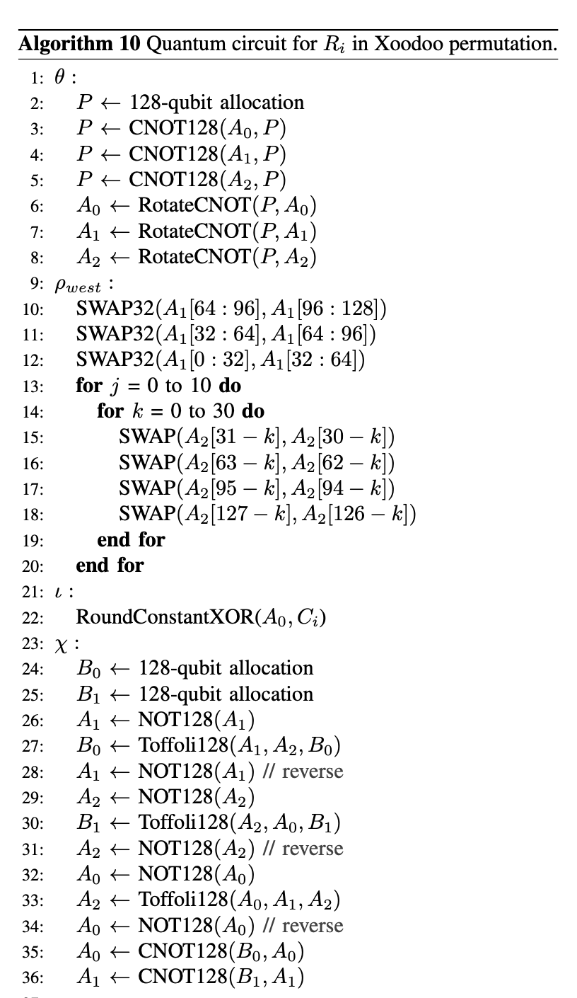
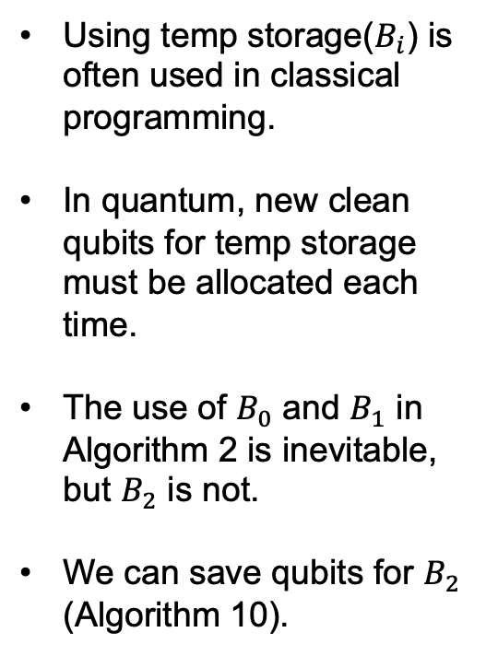
Xoodyak
Using temp storage($B_{i}$) is often used in classical programming.
In quantum, new clean qubits for temp storage must be allocated each time.
The use of $B_{0}$ and $B_{1}$ in Algorithm 2 is inevitable, but $B_{2}$ is not.
We can save qubits for $B_{2}$ (Algorithm 10).

Slide 17
SPARKLE
SPARKLE with ARX-box provides the highest performance on GPU, but not on quantum computers.
Unlike XOR(CNOT) and AND(Toffoli), addition on a quantum computer uses many quantum gates.
Also, there is no room for parallel addition(Algorithm 8) due to the sequential addition structure. → High depth

Slide 18
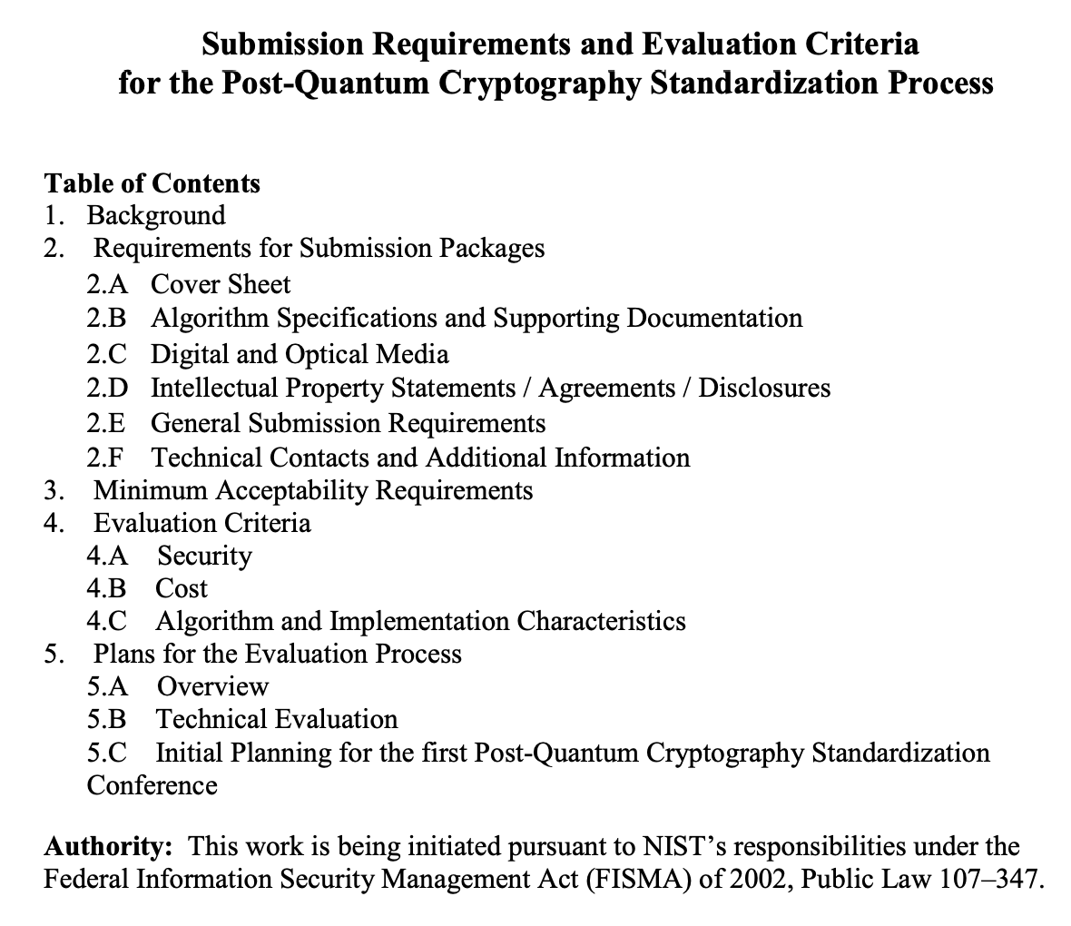
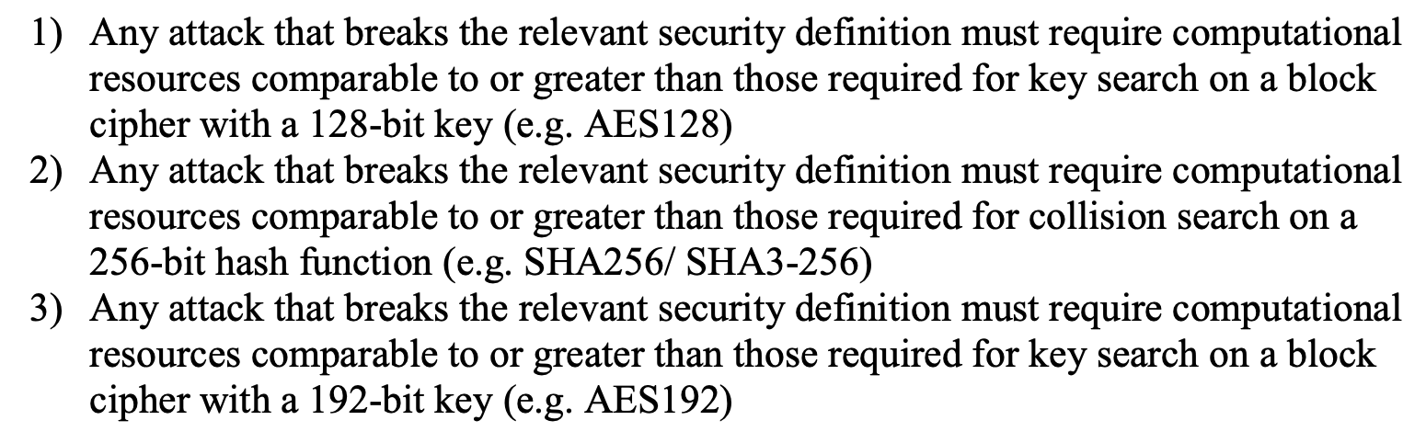
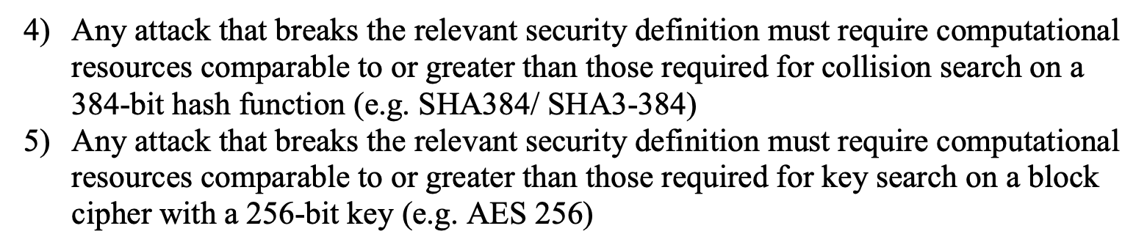
NIST’s post-quantum security requirements
Notes:
NIST에서는 Grover search 알고리즘을 적용하기위해 필요한 비용에 따라 양자 후 보안강도를 추정하고 있습니다.
비용 추정에는 AES와 SHA를 예로 들고있으며, level 2에는 SHA256, level 3에는 AES-192가 있어, SHA256이 AES192보다 쉽게 양자 공격에 노출 될 것으로 판단하고 있습니다.

Slide 19
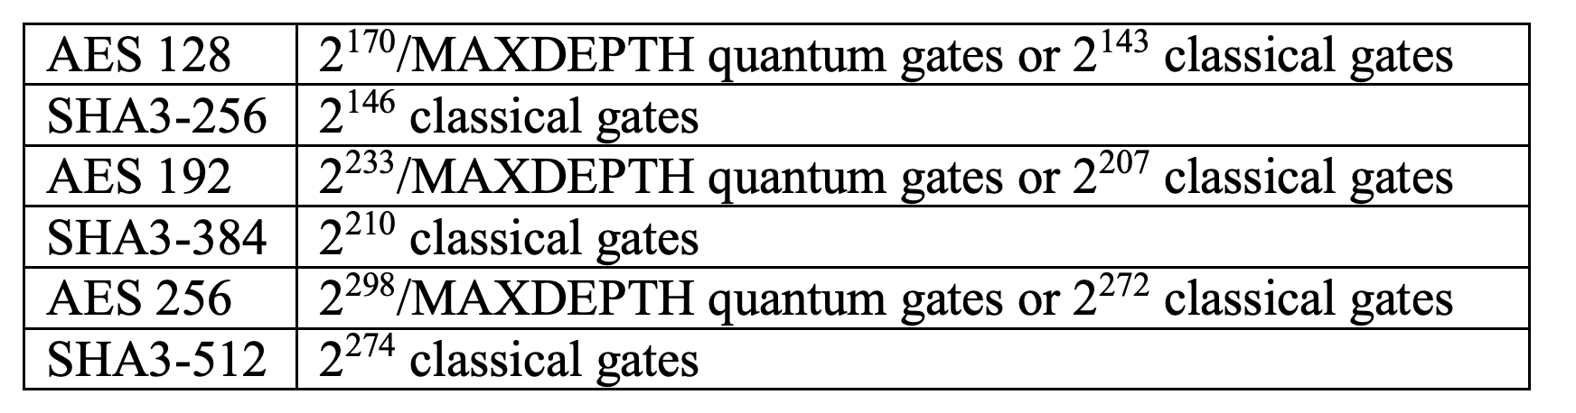
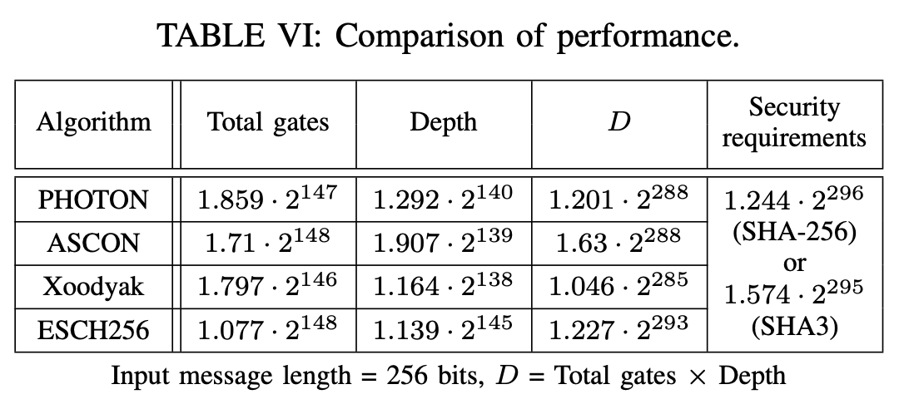
Results
NIST give the following estimates for the classical and quantum gate counts for the optimal key recovery and collision attacks on AES and SHA3.
Since the quantum gate cost for the hash function is not specified, the attack cost(Grover’s algorithm) was estimated based on the quantum circuit implementation results of SHA-256 and SHA-3.
Based on the implementation of the LWC hash function finalists, the estimated attack cost is lower than the NIST security requirements of SHA-256 and SHA-3.
(i.e. Post-quantum strength Level-1)
“Estimating the cost of generic quantum pre-image attacks on SHA-2 and SHA-3”, Matthew Amy et al.
“Applying Grover's algorithm to AES: quantum resource estimates”, Markus Grassl et al.
Notes:
NSIT에서는 AES에대한 구체적인 양자 공격 비용은 제시하였는데, 해시 함수에대한 양자 공격 비용은 제시하지 않았습니다.

Slide 20
Conclusions

Slide 21
Conclusions
All four candidates achieved high hashing throughput (70 Gbps to 1000 Gbps) on a GPU platform.
The cost of a Grover preimage attack (on quantum computer) are estimated.
This can be used to perform high performance data integrity checks in IoT communication.
We compared it with NIST’s post-quantum security requirements.
Our work contributes to the analysis of hash functions by a quantum computer.
We can also turn this implementation into a password cracking tool!
Notes:
GPU상에서의 효율적인 구현을 통해 높은 처리량을 제공합니다.
이는 데이터 무결성을 검증하는 성능을 높일 수 있습니다.
반대로 암호 해킹 툴에도 사용될 수 있습니다.
양자 컴퓨터상에서는 효율적인 구현을 통해 Grover 알고리즘을

Slide 22
THANK YOU

